Slide 1
Image Generative AI
Introduction to Generative AI.pptx

Slide 2
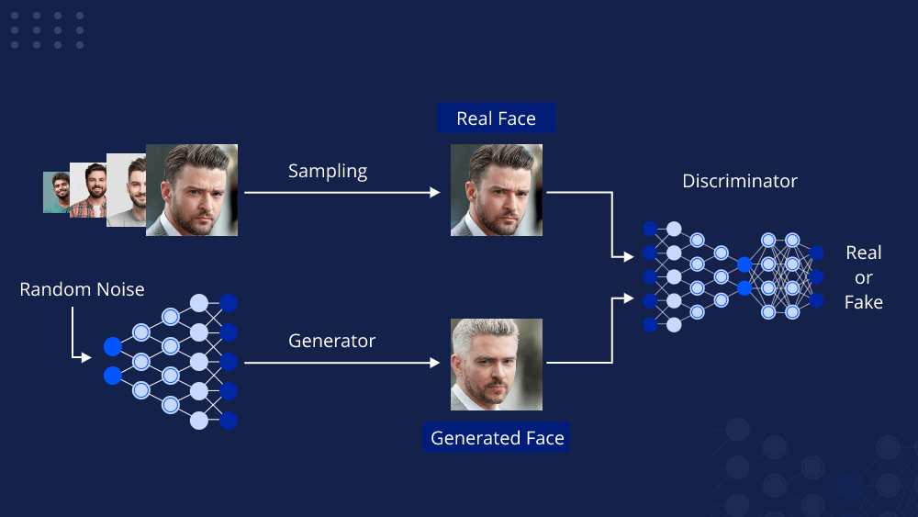
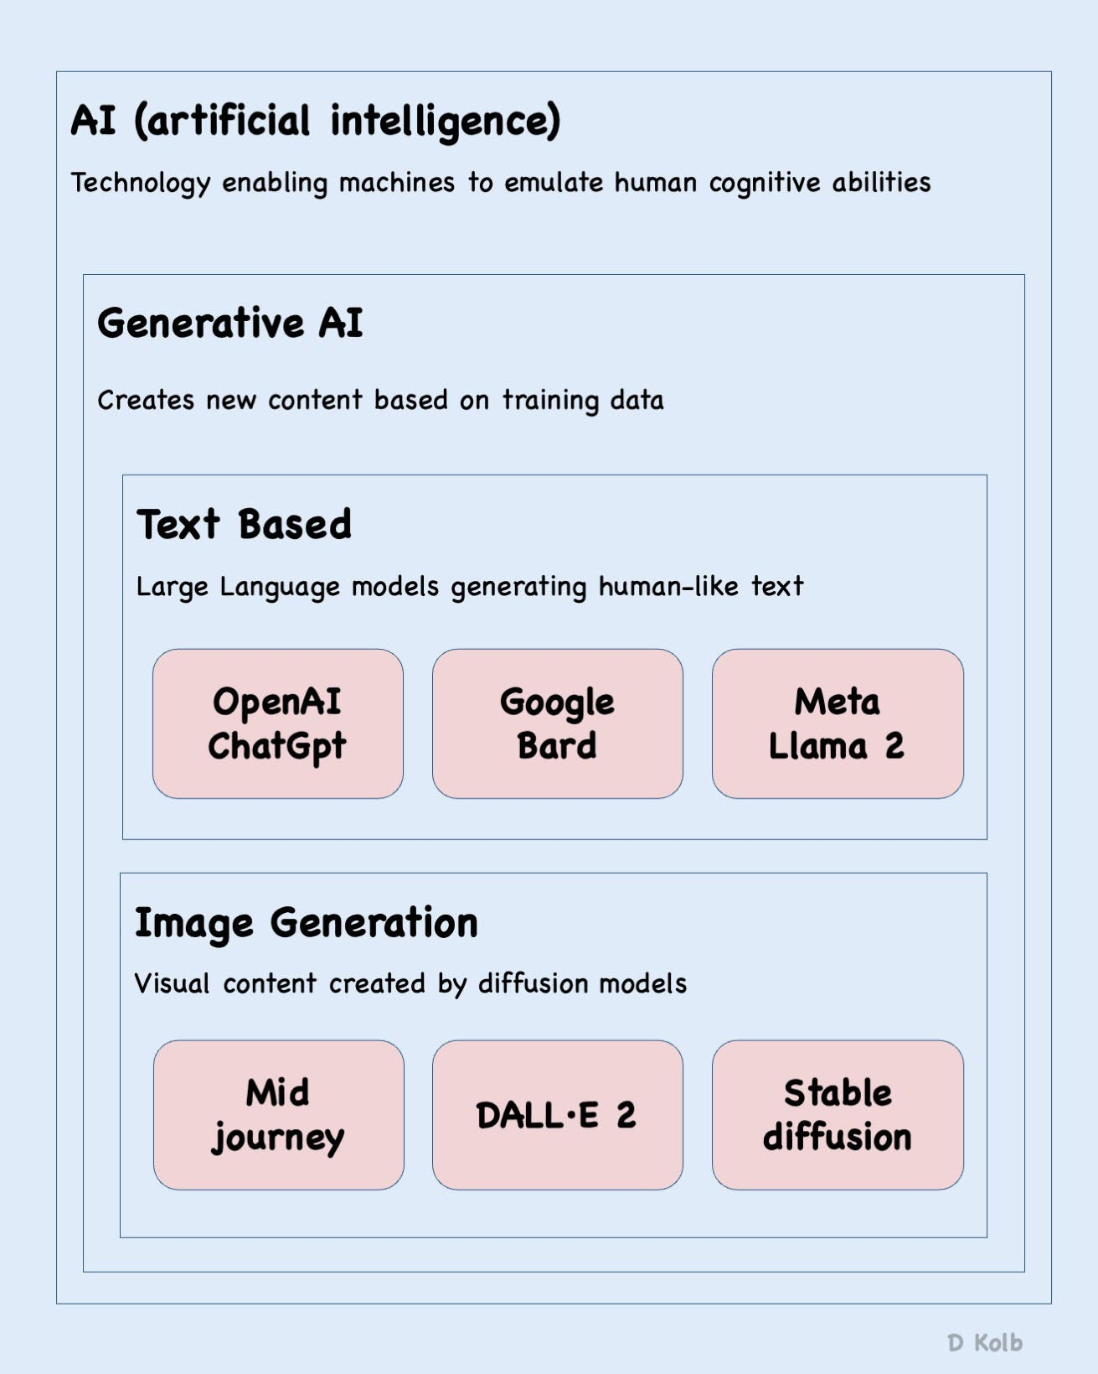
Slide 3
Generative AI models create new content (images, text, audio, video) by learning the underlying distribution of training data. Unlike discriminative models which classify, generative models generate. Key examples include GANs, VAEs, and Diffusion models. This presentation focuses on image and text generation.

Slide 3
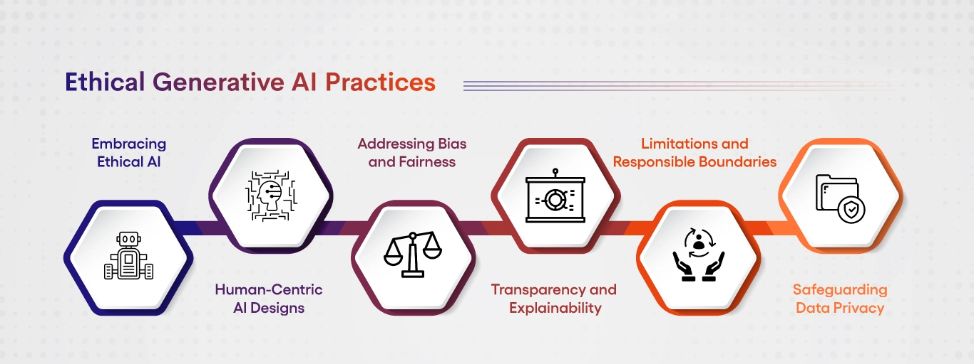
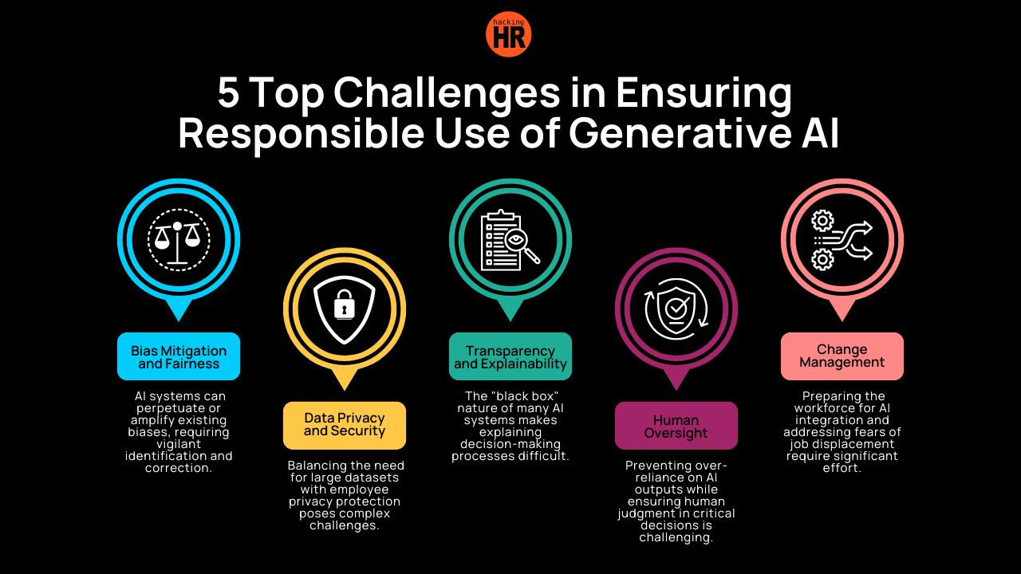
Slide 5
GANs consist of a Generator (creates synthetic data) and a Discriminator (distinguishes real from fake). They engage in an adversarial process: the generator improves realism, the discriminator improves detection. This iterative process leads to increasingly realistic outputs. Example: A GAN trained on cat images initially produces blurry images. Through adversarial training, the generator learns to create photorealistic cat images.

Slide 4
Slide 7
VAEs use a probabilistic approach, learning a compressed representation (latent space) of input data. This representation is used to generate new data. Useful for high-dimensional data like images. Example: A VAE trained on handwritten digits learns a lower-dimensional representation. Sampling from this space generates new, similar digits, or variations.

Slide 5
Slide 9
Diffusion models generate images by iteratively adding noise to an image until it's pure noise, then reverse this process to generate a new image. Known for high-quality, detailed images. Example: A diffusion model trained on landscapes starts with random noise and gradually removes it, guided by learned landscape features, to create a realistic landscape.

Slide 6
Slide 11
Applications span Art & Design (creating unique artwork), Gaming (generating assets), Medical Imaging (synthetic images for training), Film & Animation (special effects), and E-commerce (product images, personalized recommendations).

Slide 7
Slide 14
Text-based generative AI creates various text formats (articles, poems, code, scripts). These models learn patterns from massive datasets and predict the next word in a sequence, understanding nuances of language, style, and intent. Relies heavily on Large Language Models (LLMs) using transformers and attention mechanisms.

Slide 8
Slide 16
Applications include Content Creation (marketing copy, news articles), Chatbots (customer service, virtual assistants), Code Generation (assisting programmers), Translation, Summarization, and Education (personalized learning materials). Example: Marketing teams use AI to generate A/B test ad copy; customer service deploys AI-powered chatbots.

Slide 9
Slide 18
Limitations include bias (perpetuating societal biases), factual inaccuracy, misinformation, and copyright issues. Ethical considerations require careful model training, data curation, and ethical guidelines. Example: A journalist uses AI for a news report but must fact-check and refine the AI's output.

Slide 10
Slide 21
Generates new, realistic images from scratch or by manipulating existing ones. Uses GANs and VAEs. Applications span art, medicine (synthetic medical images for training), gaming (realistic textures), e-commerce, and marketing. Ethical concerns include deepfakes and misinformation.

Slide 11
Slide 23
Audio-based Generative AI creates new audio content (music, sound effects, speech). Techniques include WaveNet and spectrogram generation. Applications include music production, gaming, accessibility (text-to-speech), and voice cloning. Ethical considerations include potential misuse, copyright, and bias in training data.

